Slide 1

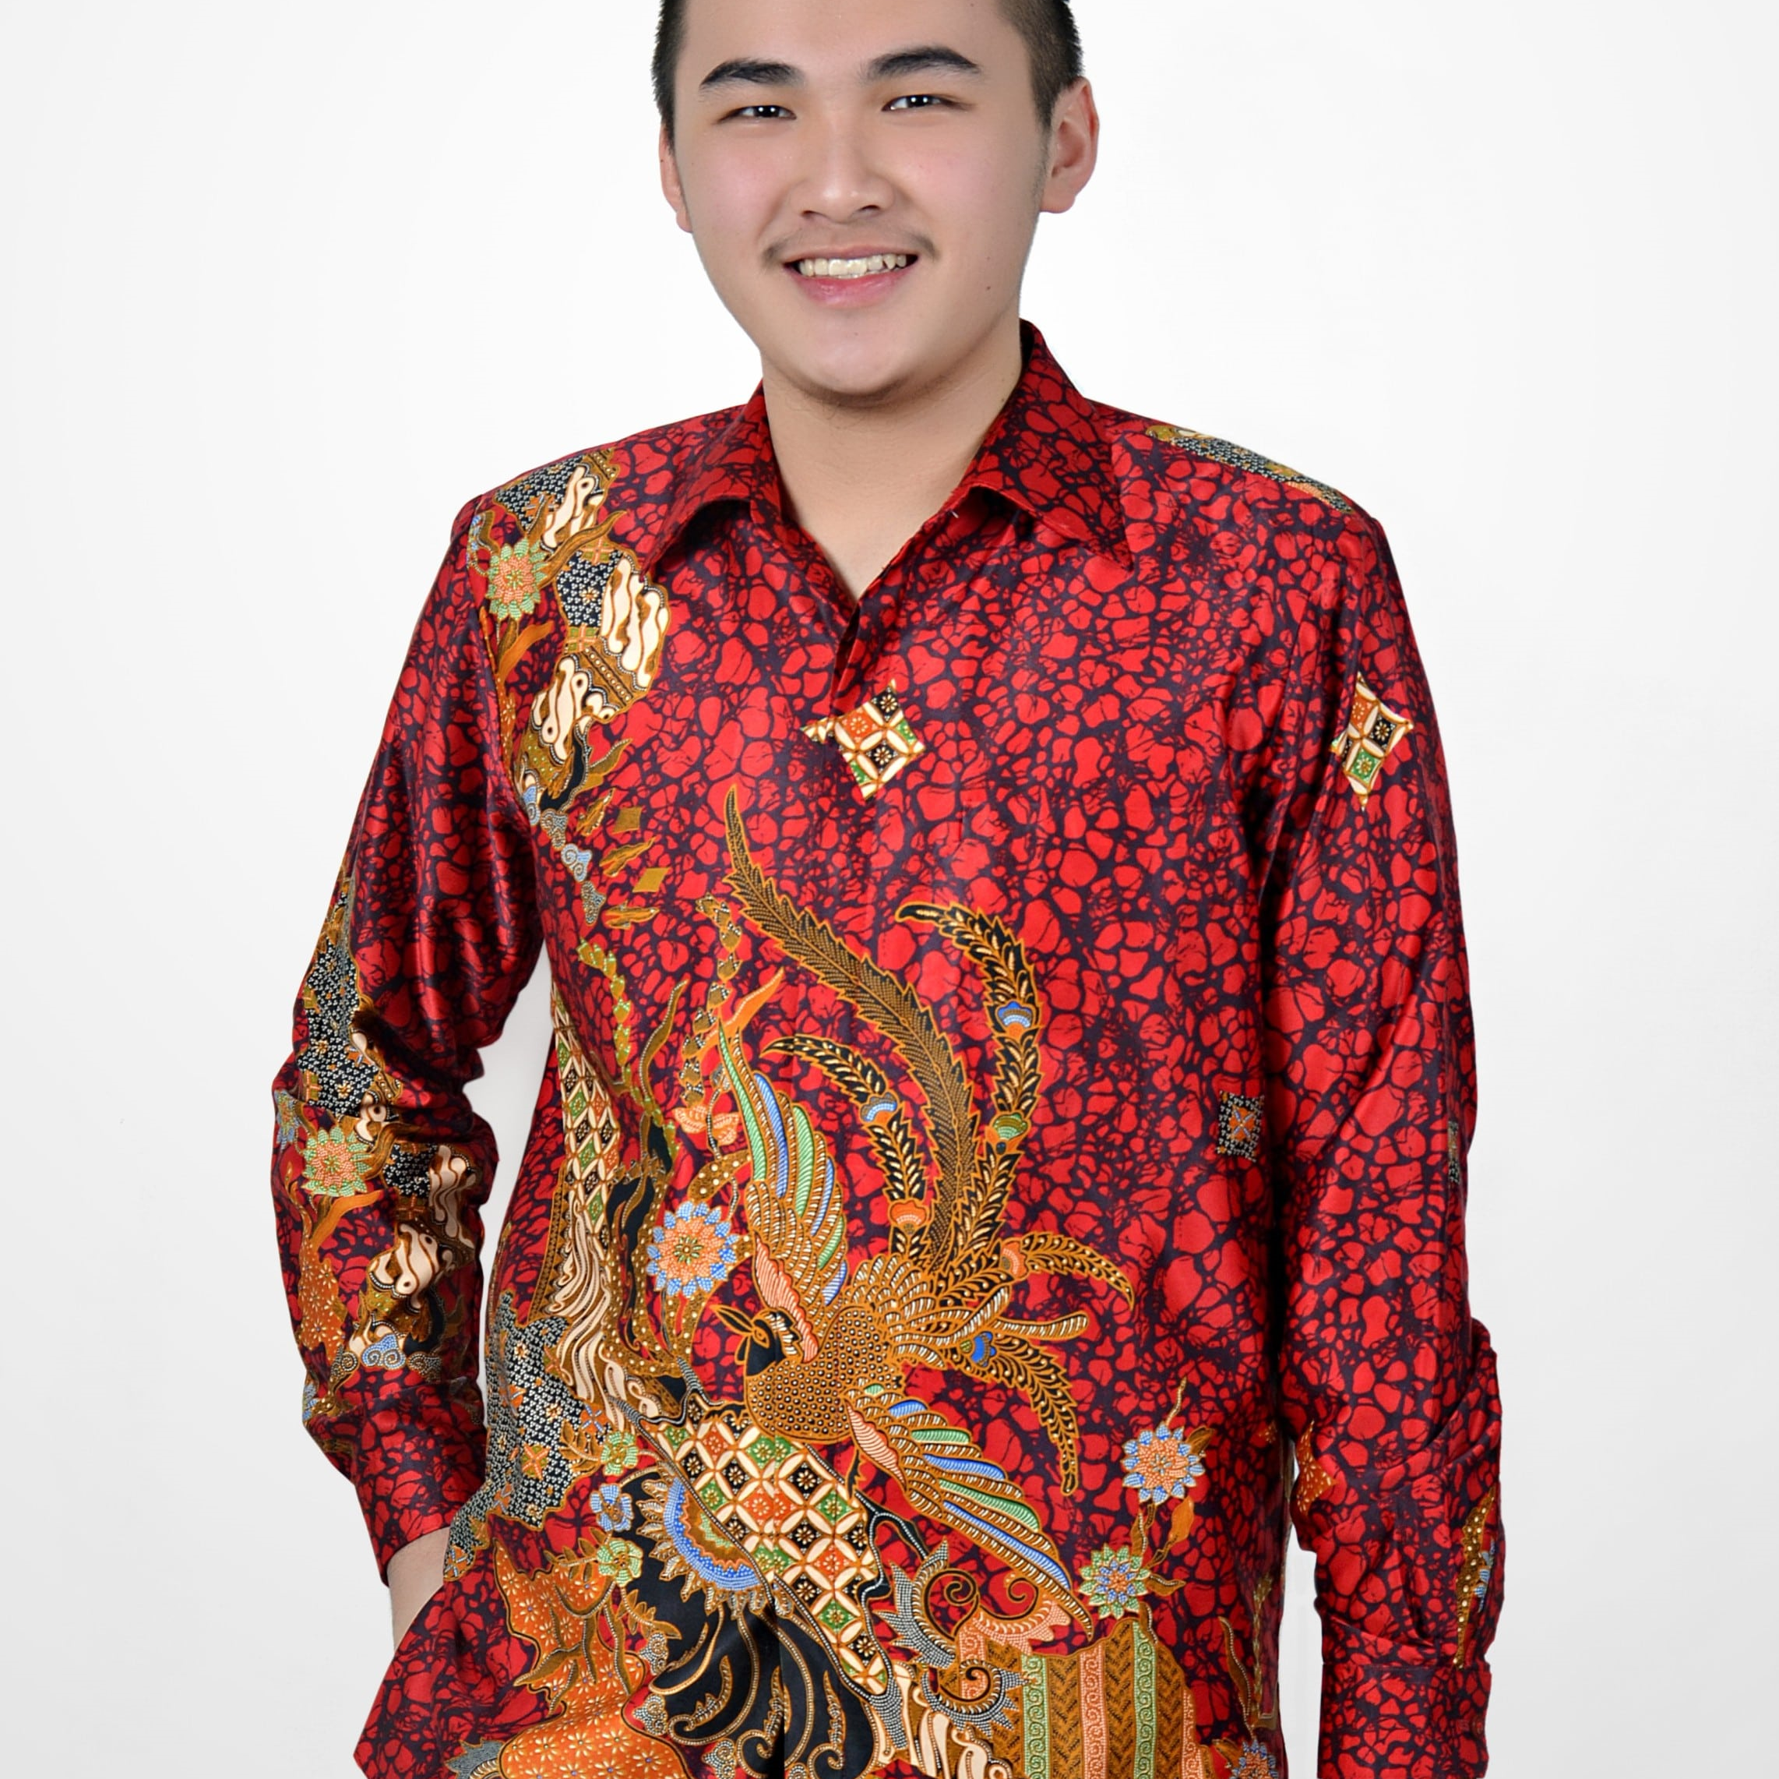
Improving Employee Retention by Predicting Employee Attrition Using Machine Learning
Created by:
Dharma Setiawan
dharmasetiawan100@gmail.com
www.linkedin.com/in/dharma-setiawan
Dharma is a highly competent Financial Engineer professional with a proven track record in data, finance, and statistic. He has strong technical skills as well as excellent interpersonal skills, enabling him to interact with a wide range of clients. He is eager to be challenged in order to grow and further improve analyzing, technical, and problem- solving skills. His greatest passion is in life is using my technical know-how to benefit other people and organizations.

Slide 2
Overview
“Sumber daya manusia (SDM) adalah aset utama yang perlu dikelola dengan baik oleh perusahaan agar tujuan bisnis dapat tercapai dengan efektif dan efisien. Pada kesempatan kali ini, kita akan menghadapi sebuah permasalahan tentang sumber daya manusia yang ada di perusahaan. Fokus kita adalah untuk mengetahui bagaimana cara menjaga karyawan agar tetap bertahan di perusahaan yang ada saat ini yang dapat mengakibatkan bengkaknya biaya untuk rekrutmen karyawan serta pelatihan untuk mereka yang baru masuk. Dengan mengetahui faktor utama yang menyebabkan karyawan tidak merasa, perusahaan dapat segera menanggulanginya dengan membuat program-program yang relevan dengan permasalahan karyawan. “
Untuk selengkapnya, dapat melihat Google Drive disini

Slide 3
Data Preprocessing
Tulislah proses data preprocessing yang kamu lakukan, dan jelaskan secara singkat bagaimana kamu melakukannya, dan alasan mengapa kamu melakukan proses tersebut.
Source code yang sudah kamu buat, dapat ditampilkan dan berikan link untuk mengakses file tersebut. Contohnya seperti di pojok kanan bawah.
Untuk selengkapnya, dapat melihat jupyter notebook disini

Slide 4
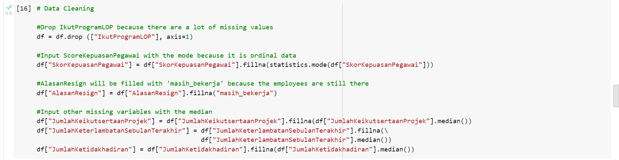
Data Preprocessing
Null Value
There are 6 features that have null values. We need to do some imputation for each category.
Untuk selengkapnya, dapat melihat jupyter notebook disini

Slide 5
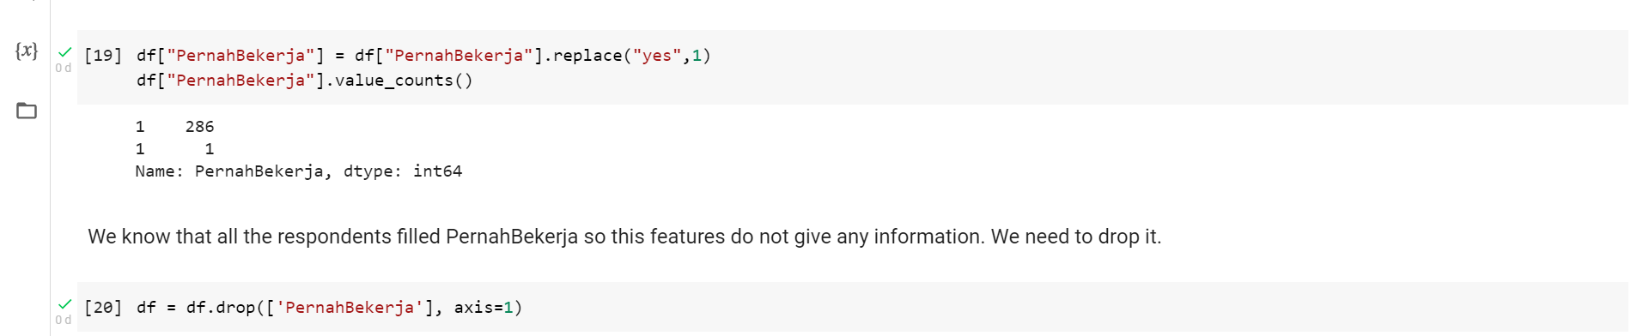
Data Preprocessing
Replacing Value and Dropping Features
There are 6 features that have null values. We need to change yes->1. Moreover, since all respondents answer that they have already worked, we can drop the features.
Untuk selengkapnya, dapat melihat jupyter notebook disini

Slide 6
Annual Report on Employee Number Changes

Slide 7
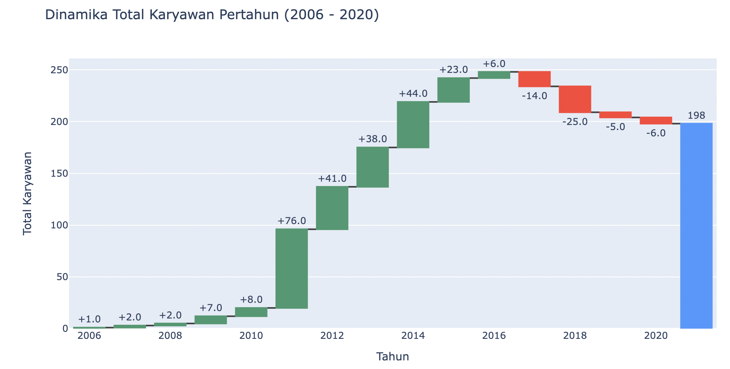
Annual Report on Employee Number Changes
The number of employee rise from 2006 to 2017. The highest increased happened in 2011 with 250% increased.
In 2017 and thereafter, the number of employees gradually decreased.
Finally, in 2021, there were only 198 employees left in this company.

Slide 8
Resign Reason Analysis for Employee Attrition Management Strategy

Slide 9
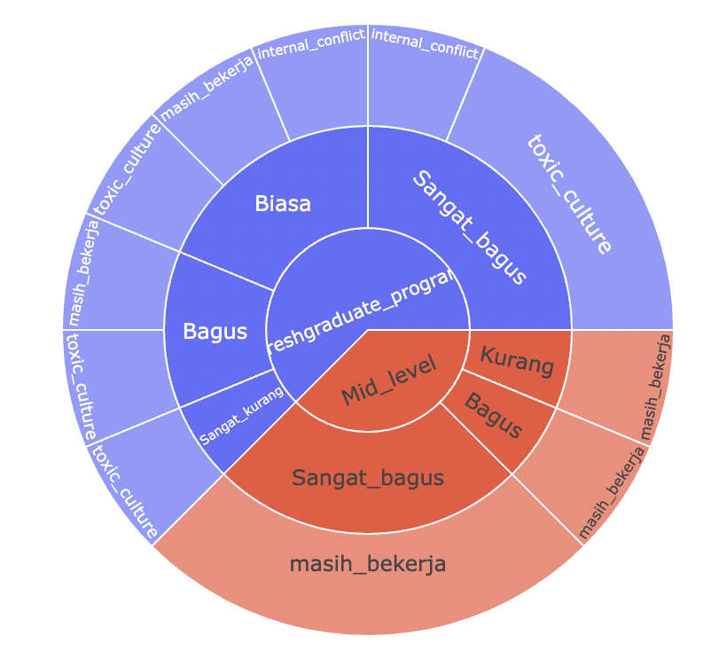
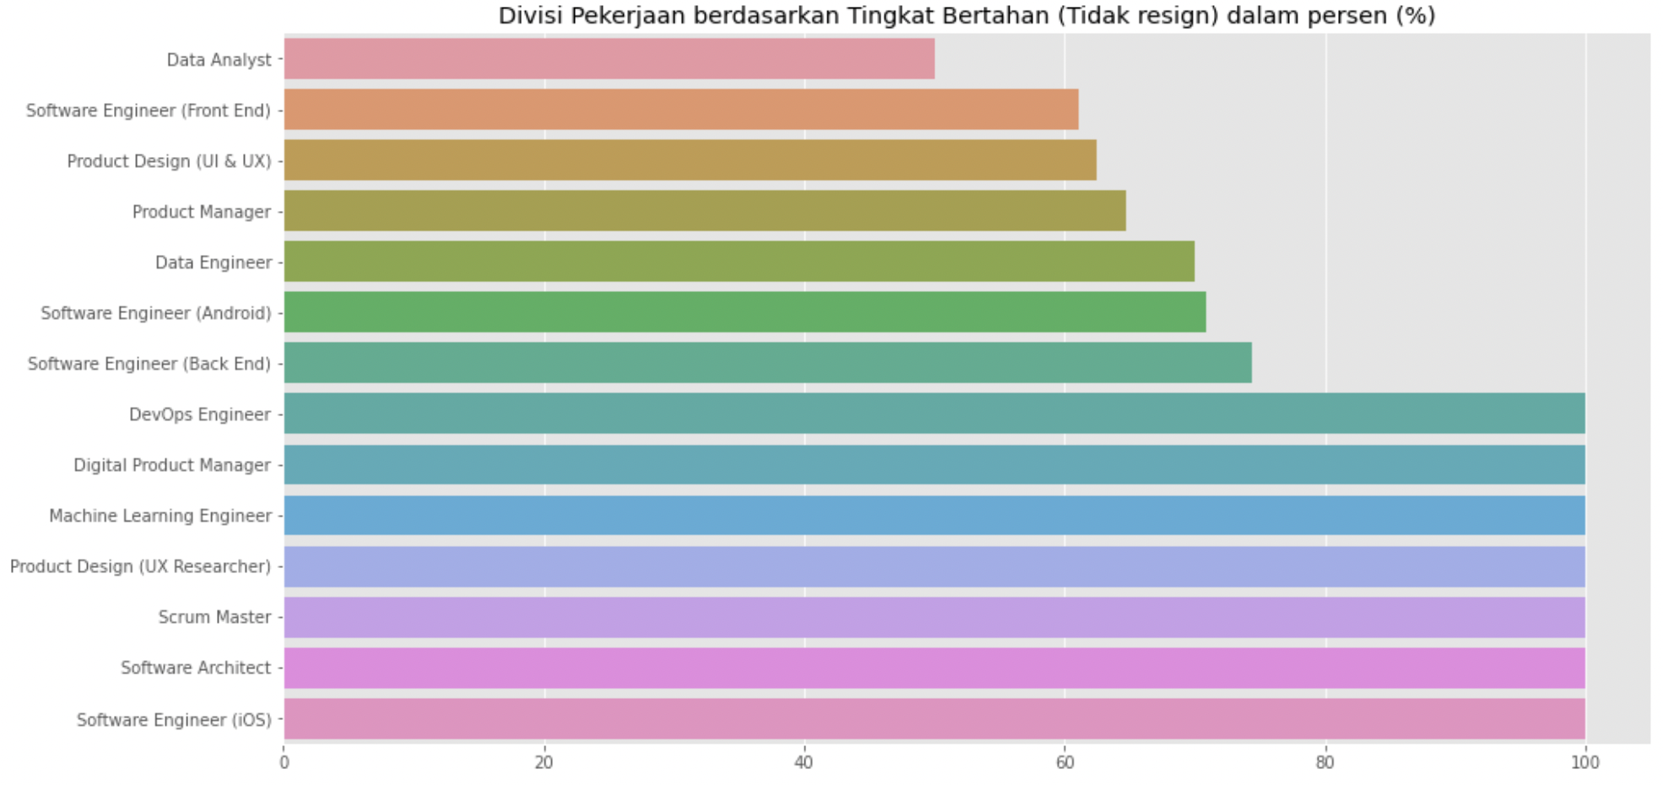
Resign Reason Analysis for Employee Attrition Management Strategy
From this chart, we know that Data Analyst has the highest resign rate compare to the other occupation.
By using the sunburst chart, we know that the majority of the people who resigned is from fresh graduate. They have the reasoned that the reason for leaving is because of toxic culture. The company needs to fix the management for Data Analyst so many fresh graduate will stay.

Slide 10
Build an Automated Resignation Behavior Prediction using Machine Learning

Slide 11
Build an Automated Resignation Behavior Prediction using Machine Learning
1
2
3
4
Data Preprocessing
Model Training
Model Selection
Hyperparameter Tuning
Handle Missing Value Handle Duplicate Data Handle Outlier Data Feature Engineering Feature Transformation
Using Imbalanced Learning Using Pipeline Using CV Method > 10 ML trained models Train on Vanilla Version
Based on Selected ML Metrics
Using Grid Search / Random Search / Bayesian Search Display Model Performance Visualization

Slide 12
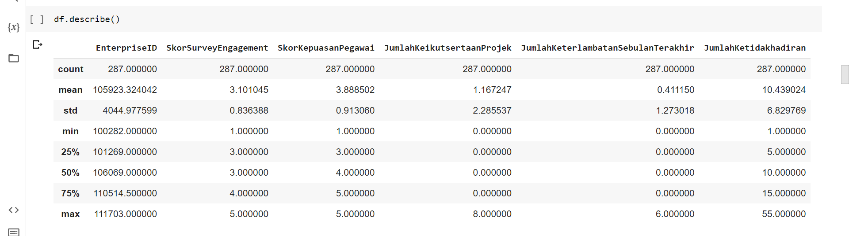
Build an Automated Resignation Behavior Prediction using Machine Learning
Exploratory Data Analysis

Slide 13
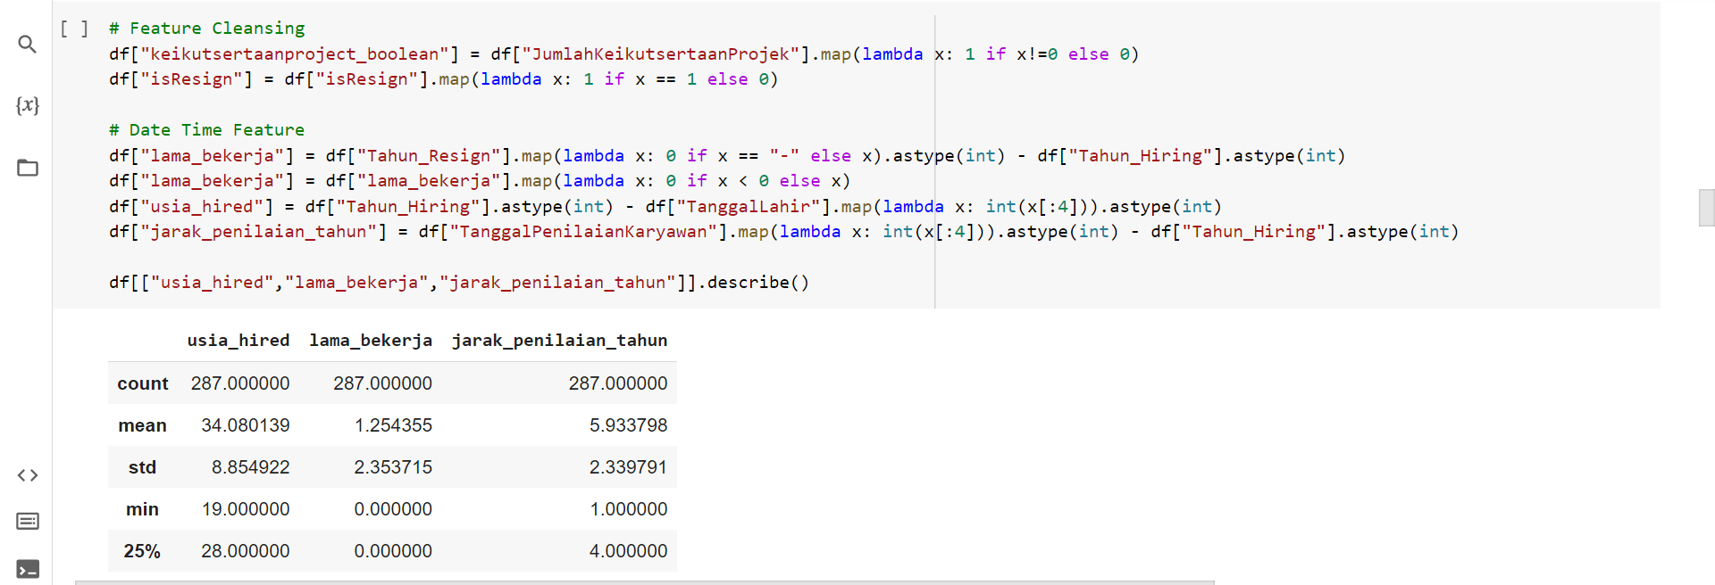
Build an Automated Resignation Behavior Prediction using Machine Learning
Data Cleansing

Slide 14
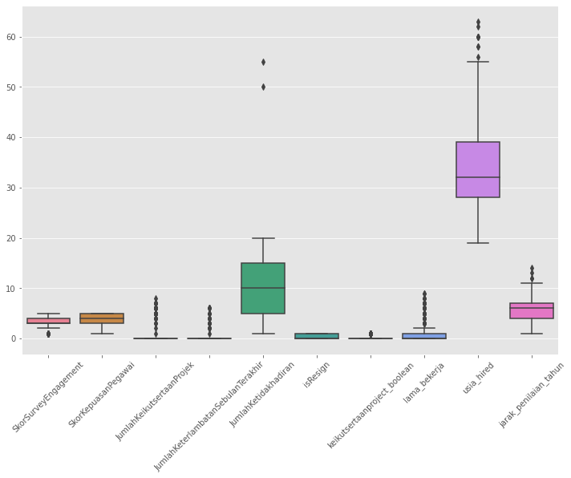
Build an Automated Resignation Behavior Prediction using Machine Learning
Outlier Handling
There is no missing value and duplicated value, but there is some outlier in the data. We use Z-score to minimize losing data. There are some variables that we can tolerate because there are only low standard deviation.

Slide 15
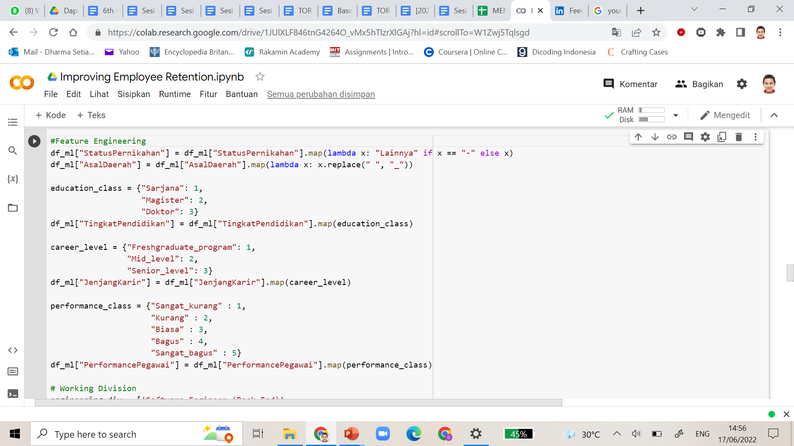
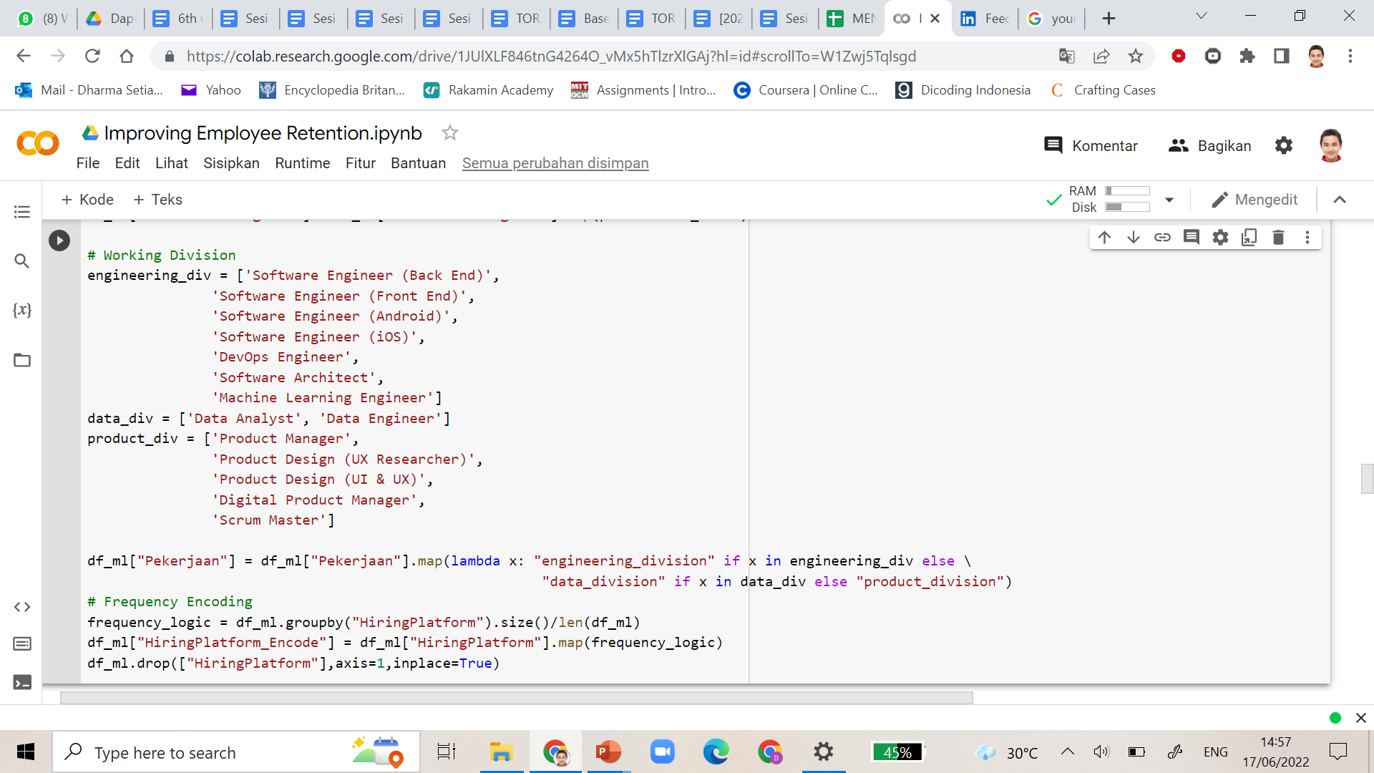
Build an Automated Resignation Behavior Prediction using Machine Learning
Feature Engineering

Slide 16
Build an Automated Resignation Behavior Prediction using Machine Learning
Feature Engineering
We will continue the process with feature engineering and transformation. Feature Engineering is a method to add the variables, and transform the type of data and format, also with making a better context data.
Feature transformation is used to transform categorical data and numerical data to be ML-ready which is all variables are numerical with low standard deviation.

Slide 17
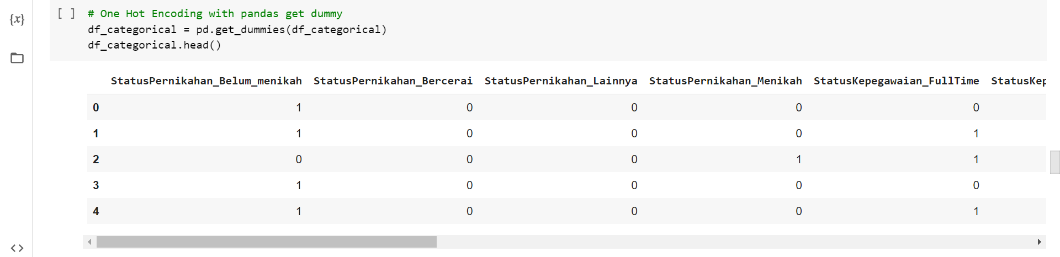
Build an Automated Resignation Behavior Prediction using Machine Learning
OHE Using Get Dummy

Slide 18
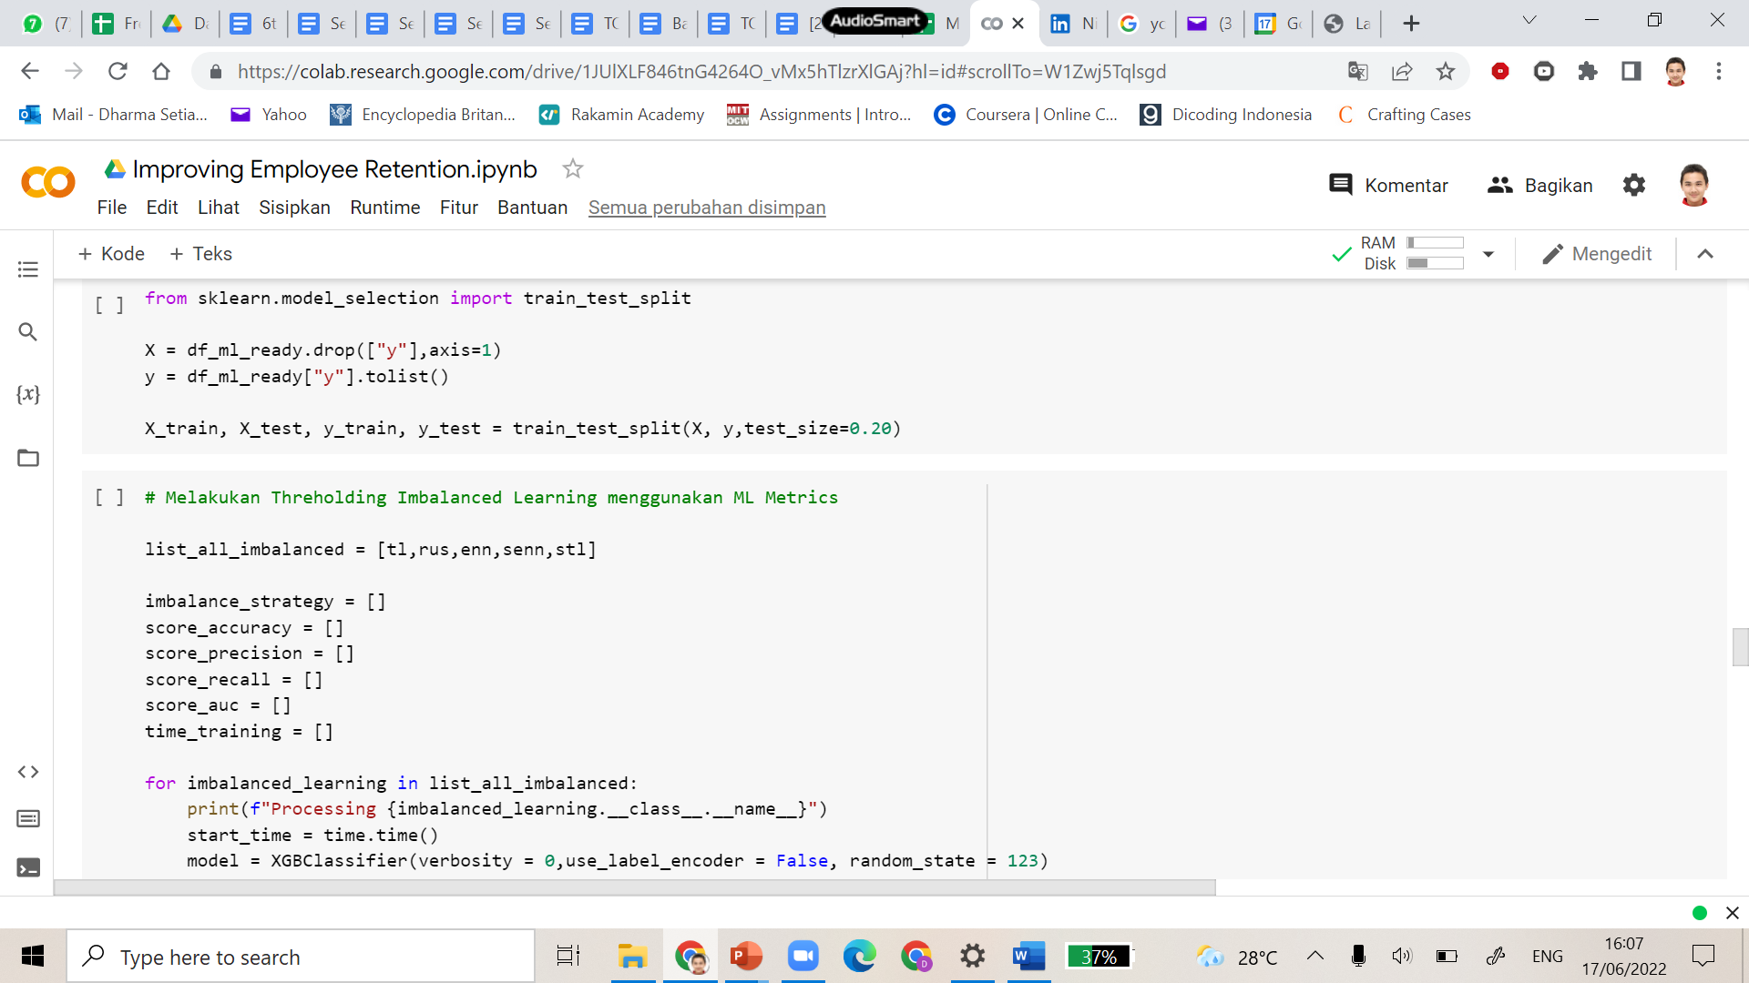
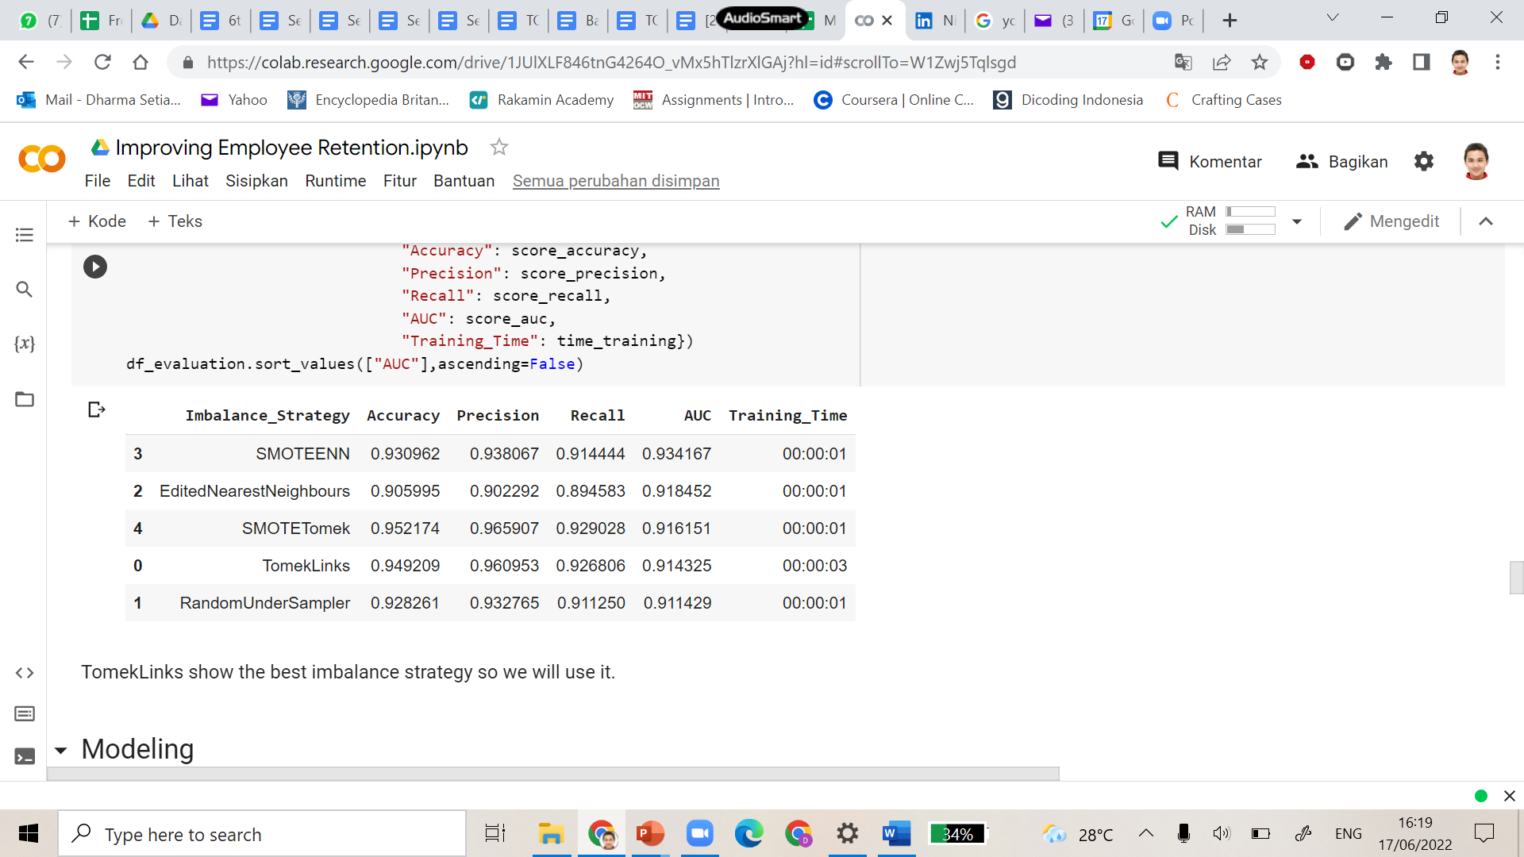
Build an Automated Resignation Behavior Prediction using Machine Learning
Train Test Split and Handle Imbalanced Data
We will divide the train with 80: 20 proportion and we also choose the best method for imbalanced data. Here, we use the TomekLinks

Slide 19
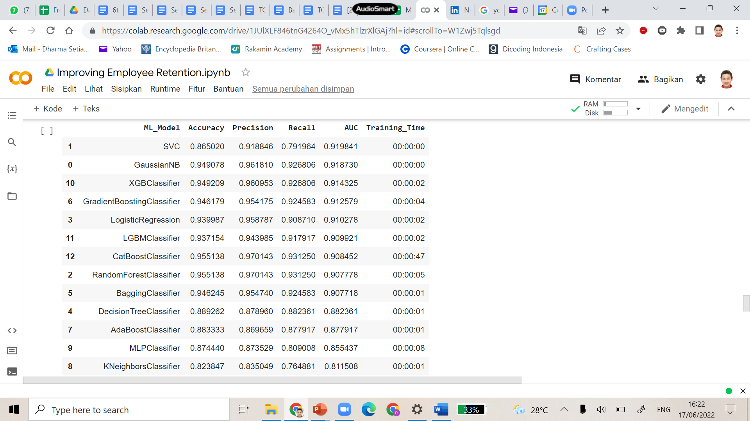
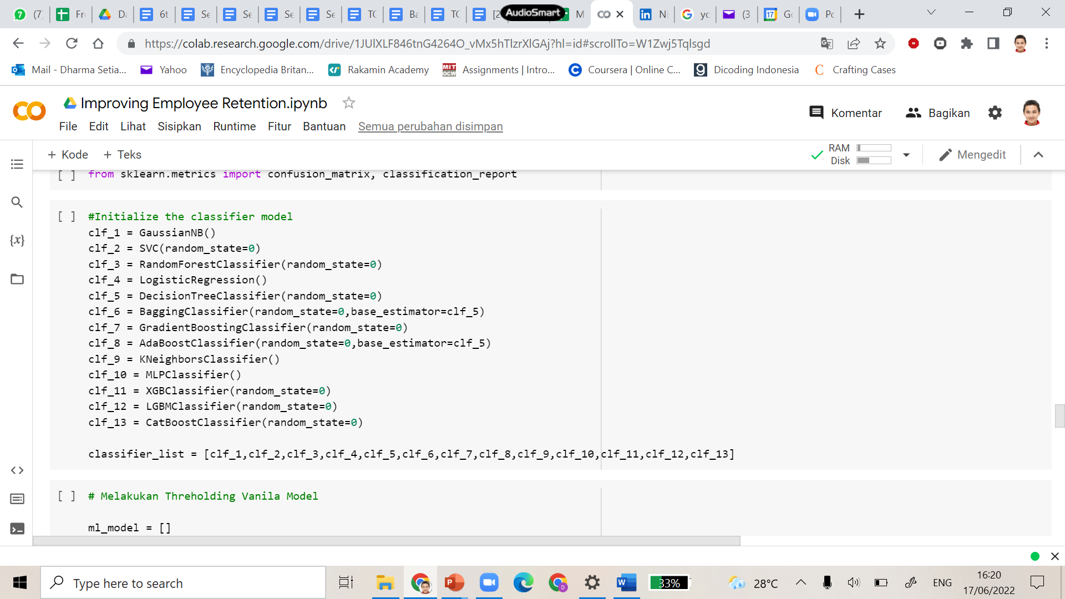
Build an Automated Resignation Behavior Prediction using Machine Learning
Modeling
We will use 13 models for choosing better prediction. We can see that XGB Classifier performs the best. We will try with the CatBoostClassifier.

Slide 20
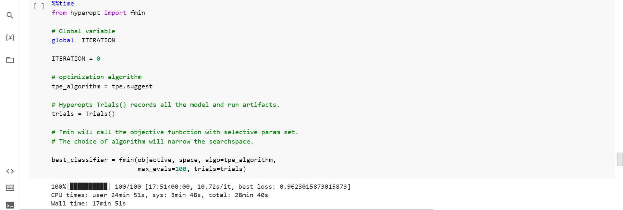
Build an Automated Resignation Behavior Prediction using Machine Learning
Hyperparameter Tuning
We will use Bayesian Search to tune our model by using a lot of iterations.

Slide 21
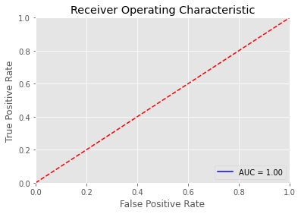
Build an Automated Resignation Behavior Prediction using Machine Learning
Results
We will build ROC curve to test how good our model.

Slide 22
Presenting Machine Learning Products to the Business Users

Slide 23
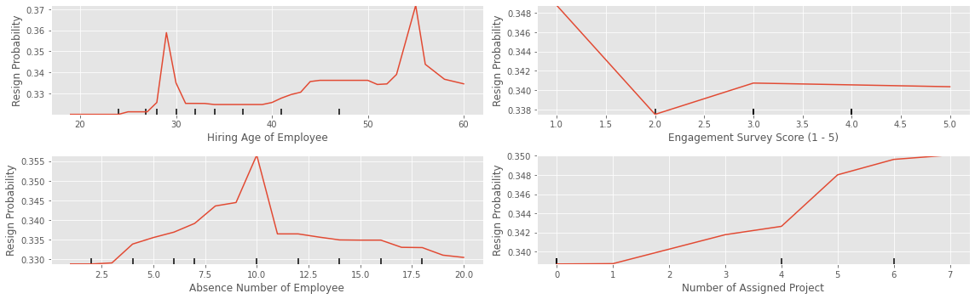
Presenting Machine Learning Products to the Business Users
Interpretation:
- The probability of resign increase sharply in the age around 27-29 years old. This age is a crucial. The probability of resign for an employee with the age more than 45 increase almost 5 times from employee with younger age.
-Based on engagement survey, the employee who write score 1 are more likely to resign compared to employees who write score 2-5.
-Based on jumlah ketidakhadiran karyawan, employee who absence more than 5 days, are more likely to resign compared to employee who attend less than 5 days.
-Based on jumlah keikutsertaan project, the more often the employee join the project, it turns out that it is not good for them so they are more likely to resign, especially for the employee who joined more than 4 projects.

Slide 24
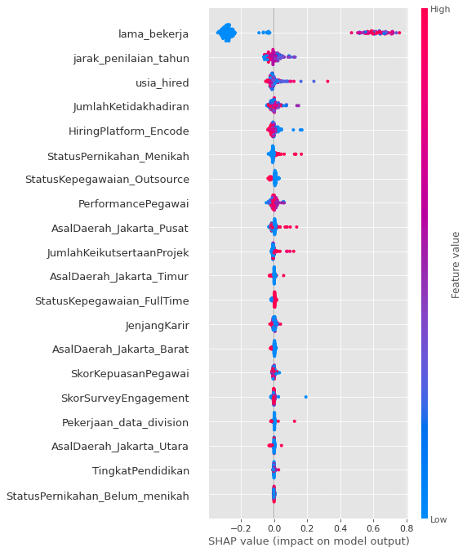
Presenting Machine Learning Products to the Business Users
Based on Shapley Values:
-There are 3 main features who impact the resign rate, such as lama_bekerja, jarak_penilaian_tahun, and usia_hired.
-The longer the employee work, the higher the probability of resign. The older the employee that got hired, the higher the chance of the probability to resign.
-The lower employee attendance, the higher the chance to resign. Employee that got hired in online-web based, other, website are more likely to resign compared to via LinkedIn, Indeed, and Google Search.
-The higher keikutsertaan project karyawan the higher the chance to get resign

Slide 25
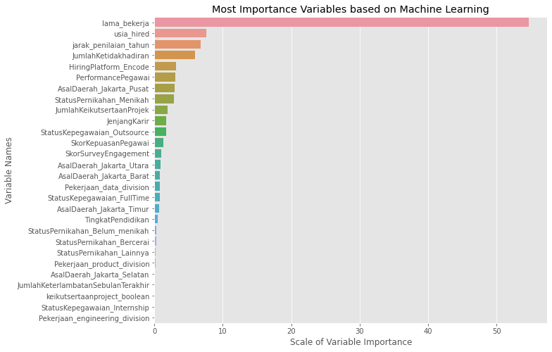
Presenting Machine Learning Products to the Business Users

